Slide 1
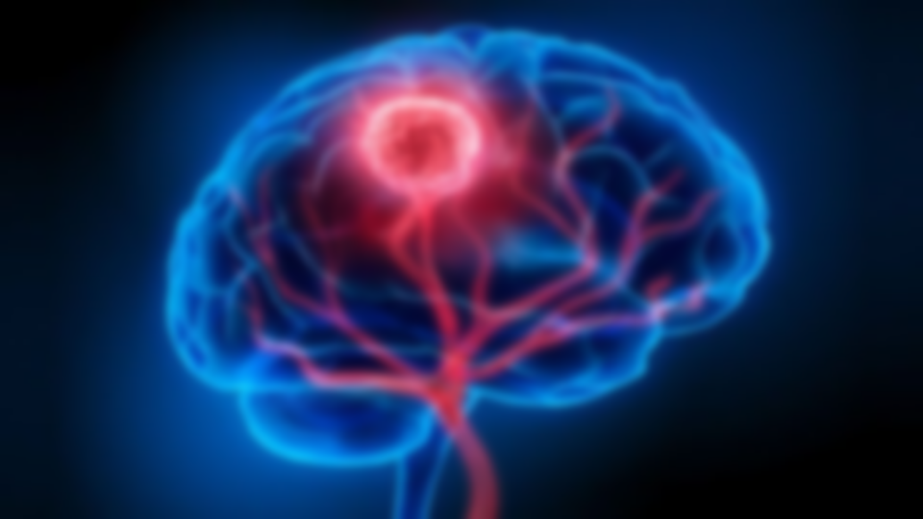

Basaveshwar Engineering College Bagalkote
Department of Electronics and Communication Engineering
MINI PROJECT
Brain Tumors Detection
Project coordinator: Project Guide: Prof. L.P. Kolur Dr. V.C.Kagawade
GROUP MEMBERS
SL.NO | NAME | USN
1. | Harish G Rolli | 2BA21AI021
2. | Subramanya Ratnakar | 2BA21AI052
3. | Mohanrao Kulkarni | 2BA21AI028
4. | Veeresh Pattanad | 2BA21AI061

Slide 2
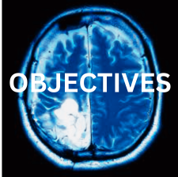
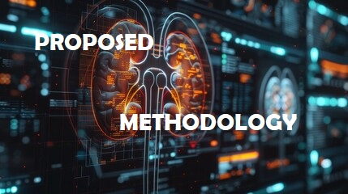

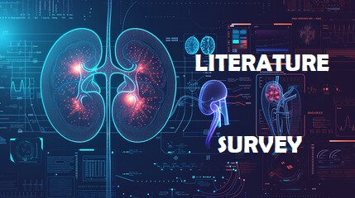

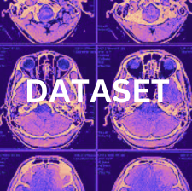
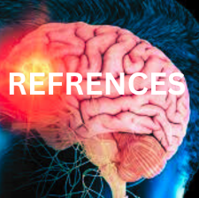
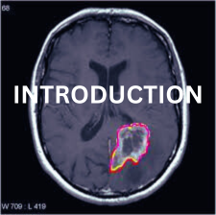
TABLE OF CONTENT

Slide 3
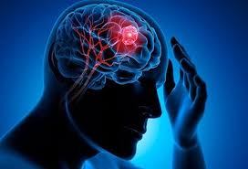
INTRODUCTION
What is Brain Tumor?
Brain tumors are a significant health concern worldwide, with diverse types and complexities impacting patients' lives.
Early detection plays a crucial role in improving treatment outcomes and patient survival rates.
This study focuses on developing a robust system for detecting brain tumors using machine learning and image processing techniques.

Slide 4
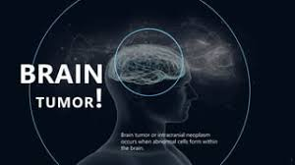
OBJECTIVES
Primary Objectives are :
To develop a machine-learning model for accurate brain tumor detection.
To enhance existing methods for segmentation and classification of brain tumor images.
To evaluate the performance of the developed model on a comprehensive dataset.

Slide 5
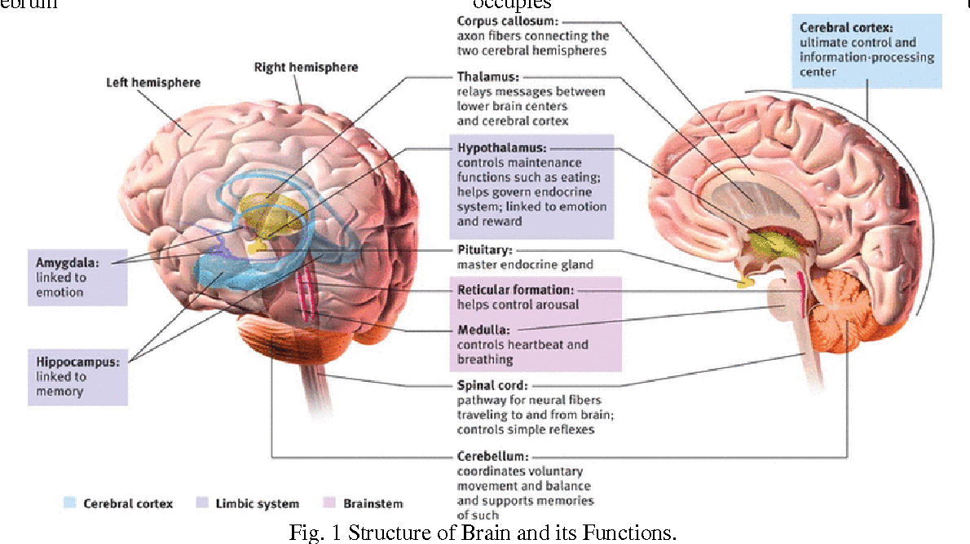
LITERATURE REVIEW
Previous research in brain tumor detection has primarily utilized techniques such as MRI imaging, machine learning algorithms, and deep learning models.
Various studies have highlighted the importance of accurate segmentation and classification methods in enhancing diagnostic accuracy.
Challenges include dealing with noise in imaging data, handling class imbalance, and ensuring the robustness of models across different patient demographics.

Slide 6
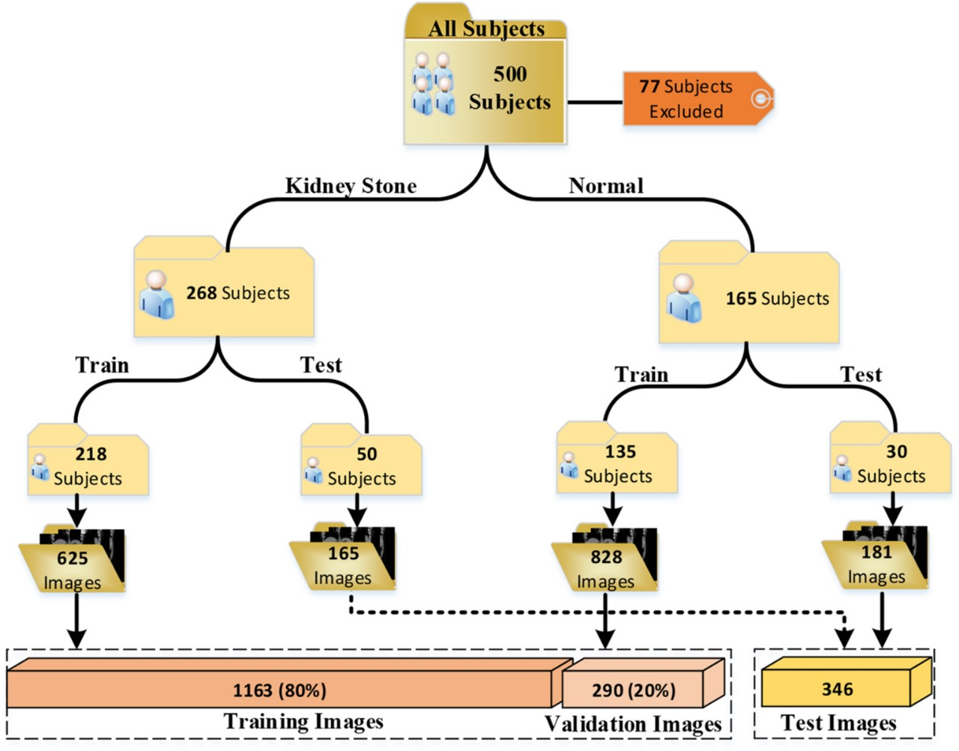
PROPOSED METHODOLOGY
1. Data Collection
Gather a diverse dataset of brain MRI scans, including both tumor and non-tumor cases.
2. Preprocessing.
Normalize and preprocess MRI images to enhance feature extraction and reduce noise.

Slide 7
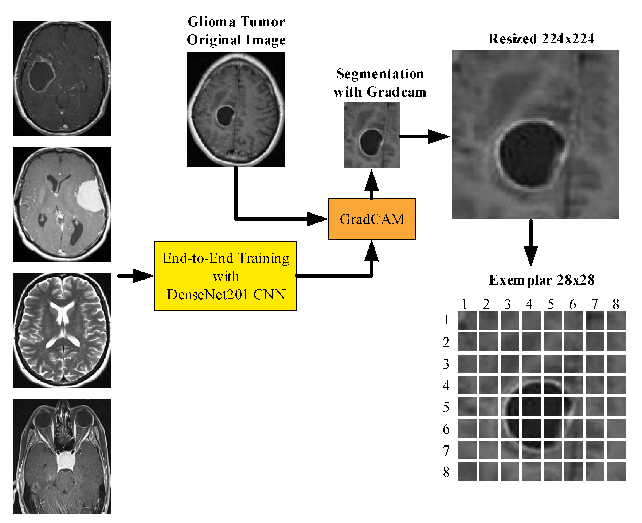
PROPOSED METHODOLOGY
3. Features Extraction
Utilize image processing techniques to extract relevant features from MRI scans.

Slide 8
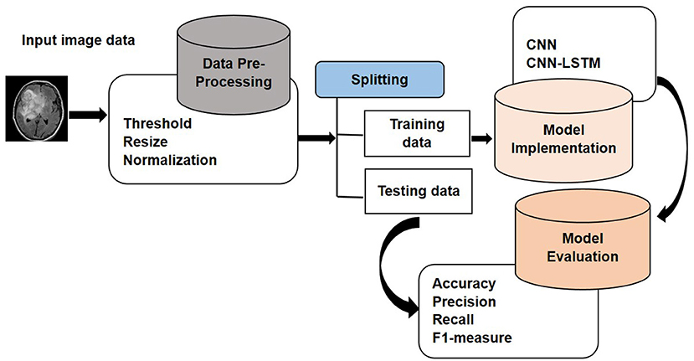
PROPOSED METHODOLOGY
4. Model Development
Implement machine learning algorithms (e.g., SVM, Random Forest) and deep learning models (e.g., CNNs) for tumor detection.
5. Evaluation
Assess the performance of the models using metrics such as accuracy, sensitivity, specificity, and ROC curves.

Slide 9
DATASETS
The dataset used in this study consists of MRI scans collected from multiple medical centers, ensuring variability in patient demographics, imaging protocols, and tumor types. It includes annotated images for training and validation purposes.

Slide 10




WORK PROGRESS
Work Done Until Now:
Work to be
Done:

Slide 11
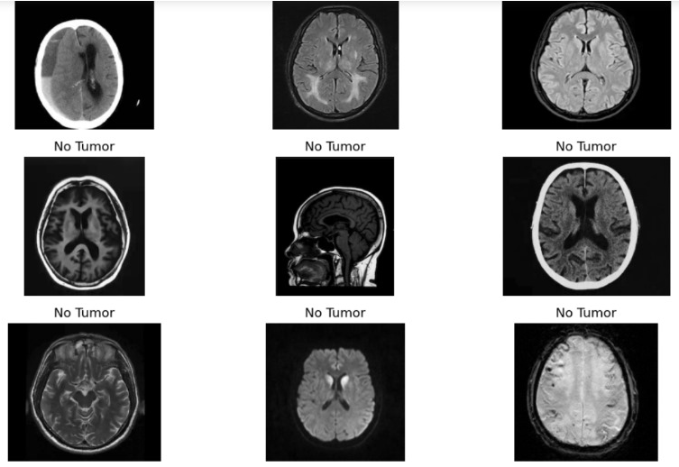
WORK DONE UNTIL NOW
1. Data Collection:
Acquired a substantial dataset of brain MRI scans.
2. Preprocessing:
Completed normalization and preprocessing steps to prepare data for modeling.
3. Model Development:
Implemented initial machine learning and deep learning models for tumor detection.
4. Evaluation:
Conducted preliminary evaluation of models using standard metrics.
Training Model

Slide 12
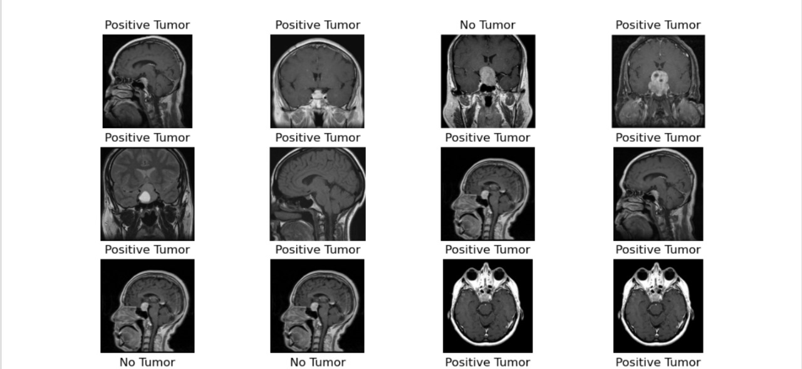
WORK TO BE DONE
1. Refinement of Models
Fine-tune machine learning and deep learning models to improve accuracy and robustness.
2. Enhanced Feature Extraction:
Explore advanced techniques for feature extraction from MRI images.
3. Validation and Testing:
Validate models on a larger scale with cross-validation and test on unseen data to ensure generalizability.
4. Comparison with State-of-the-Art:
Compare developed models with existing state-of-the-art methods in brain tumor detection.
5. Documentation and Reporting:
Prepare comprehensive documentation and reports detailing methodology, results, and recommendations.
TESTING Model

Slide 13
REFERENCES
1. Annapa V N Reddy, Chitta Venkata Phani Krishna,” CONTENT BASED IMAGE RETRIEVAL FOR DETECTING BRAIN TUMOR”.
2. Nameirakpam Dhanachandra, ”Image Segmentation using K-means Clustering Algorithm”, National Institute of Technology, Manipur. Automatic kidney segmentation in ultrasound images using subsequent boundary distance regression and pixel-wise classification networks.
3. “Detection of Brain Tumor from MRI Images”, Riddhi.S.Kapse, Dr. S.S. Salankar, Madhuri.
4. “A survey on detection of brain tumor from MRI brain images”, S U Swathy; G. Glan Deva Dhas; S S Kumar
5. “Brain Tumor Detection based on Machine Learning Algorithms “, Komal Sharma, Akwinder Kaur, Shruti Gujral

Slide 14
THANK YOU

